Slide 1

Robot Operating System (ROS)
Introductory workshop – 19.01.2022
Norwegian University of Science and Technology
Bjørnar Hogstad

Slide 2
Roadmap for today
Introduction and core concepts
Break
Code examples
Another break
Previous work with the BlueROV2

Slide 3
Introduction and Core Concepts

Slide 4
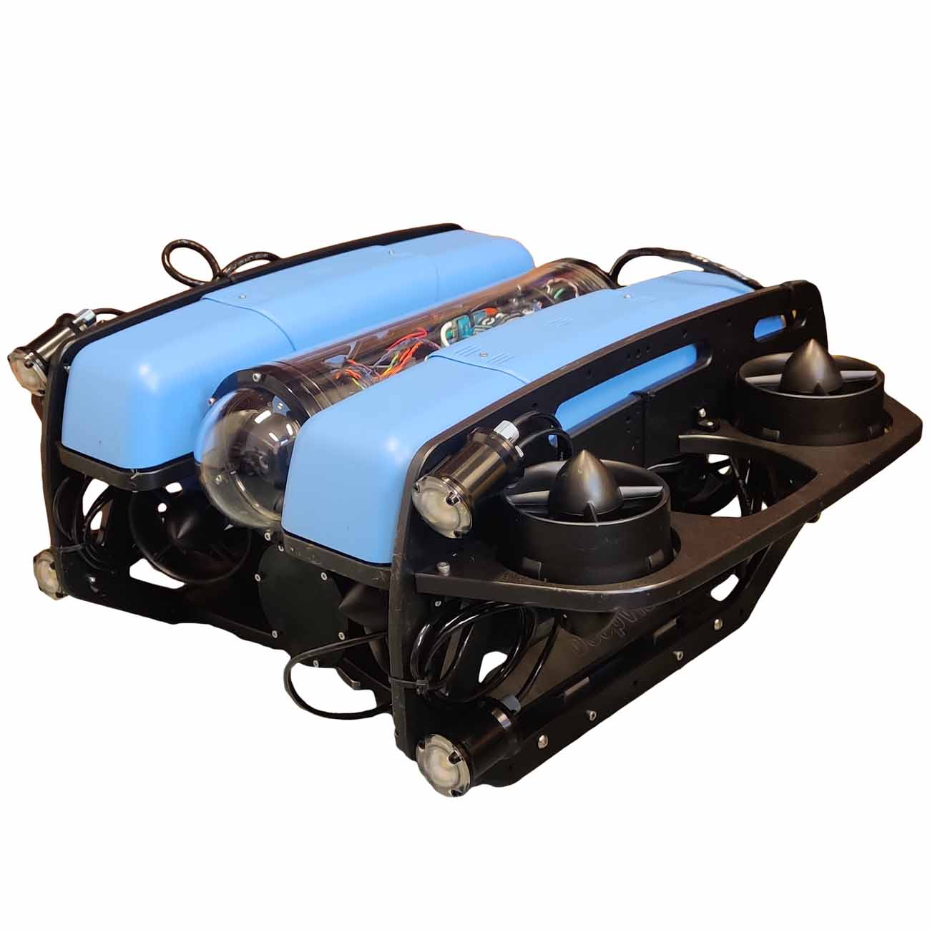
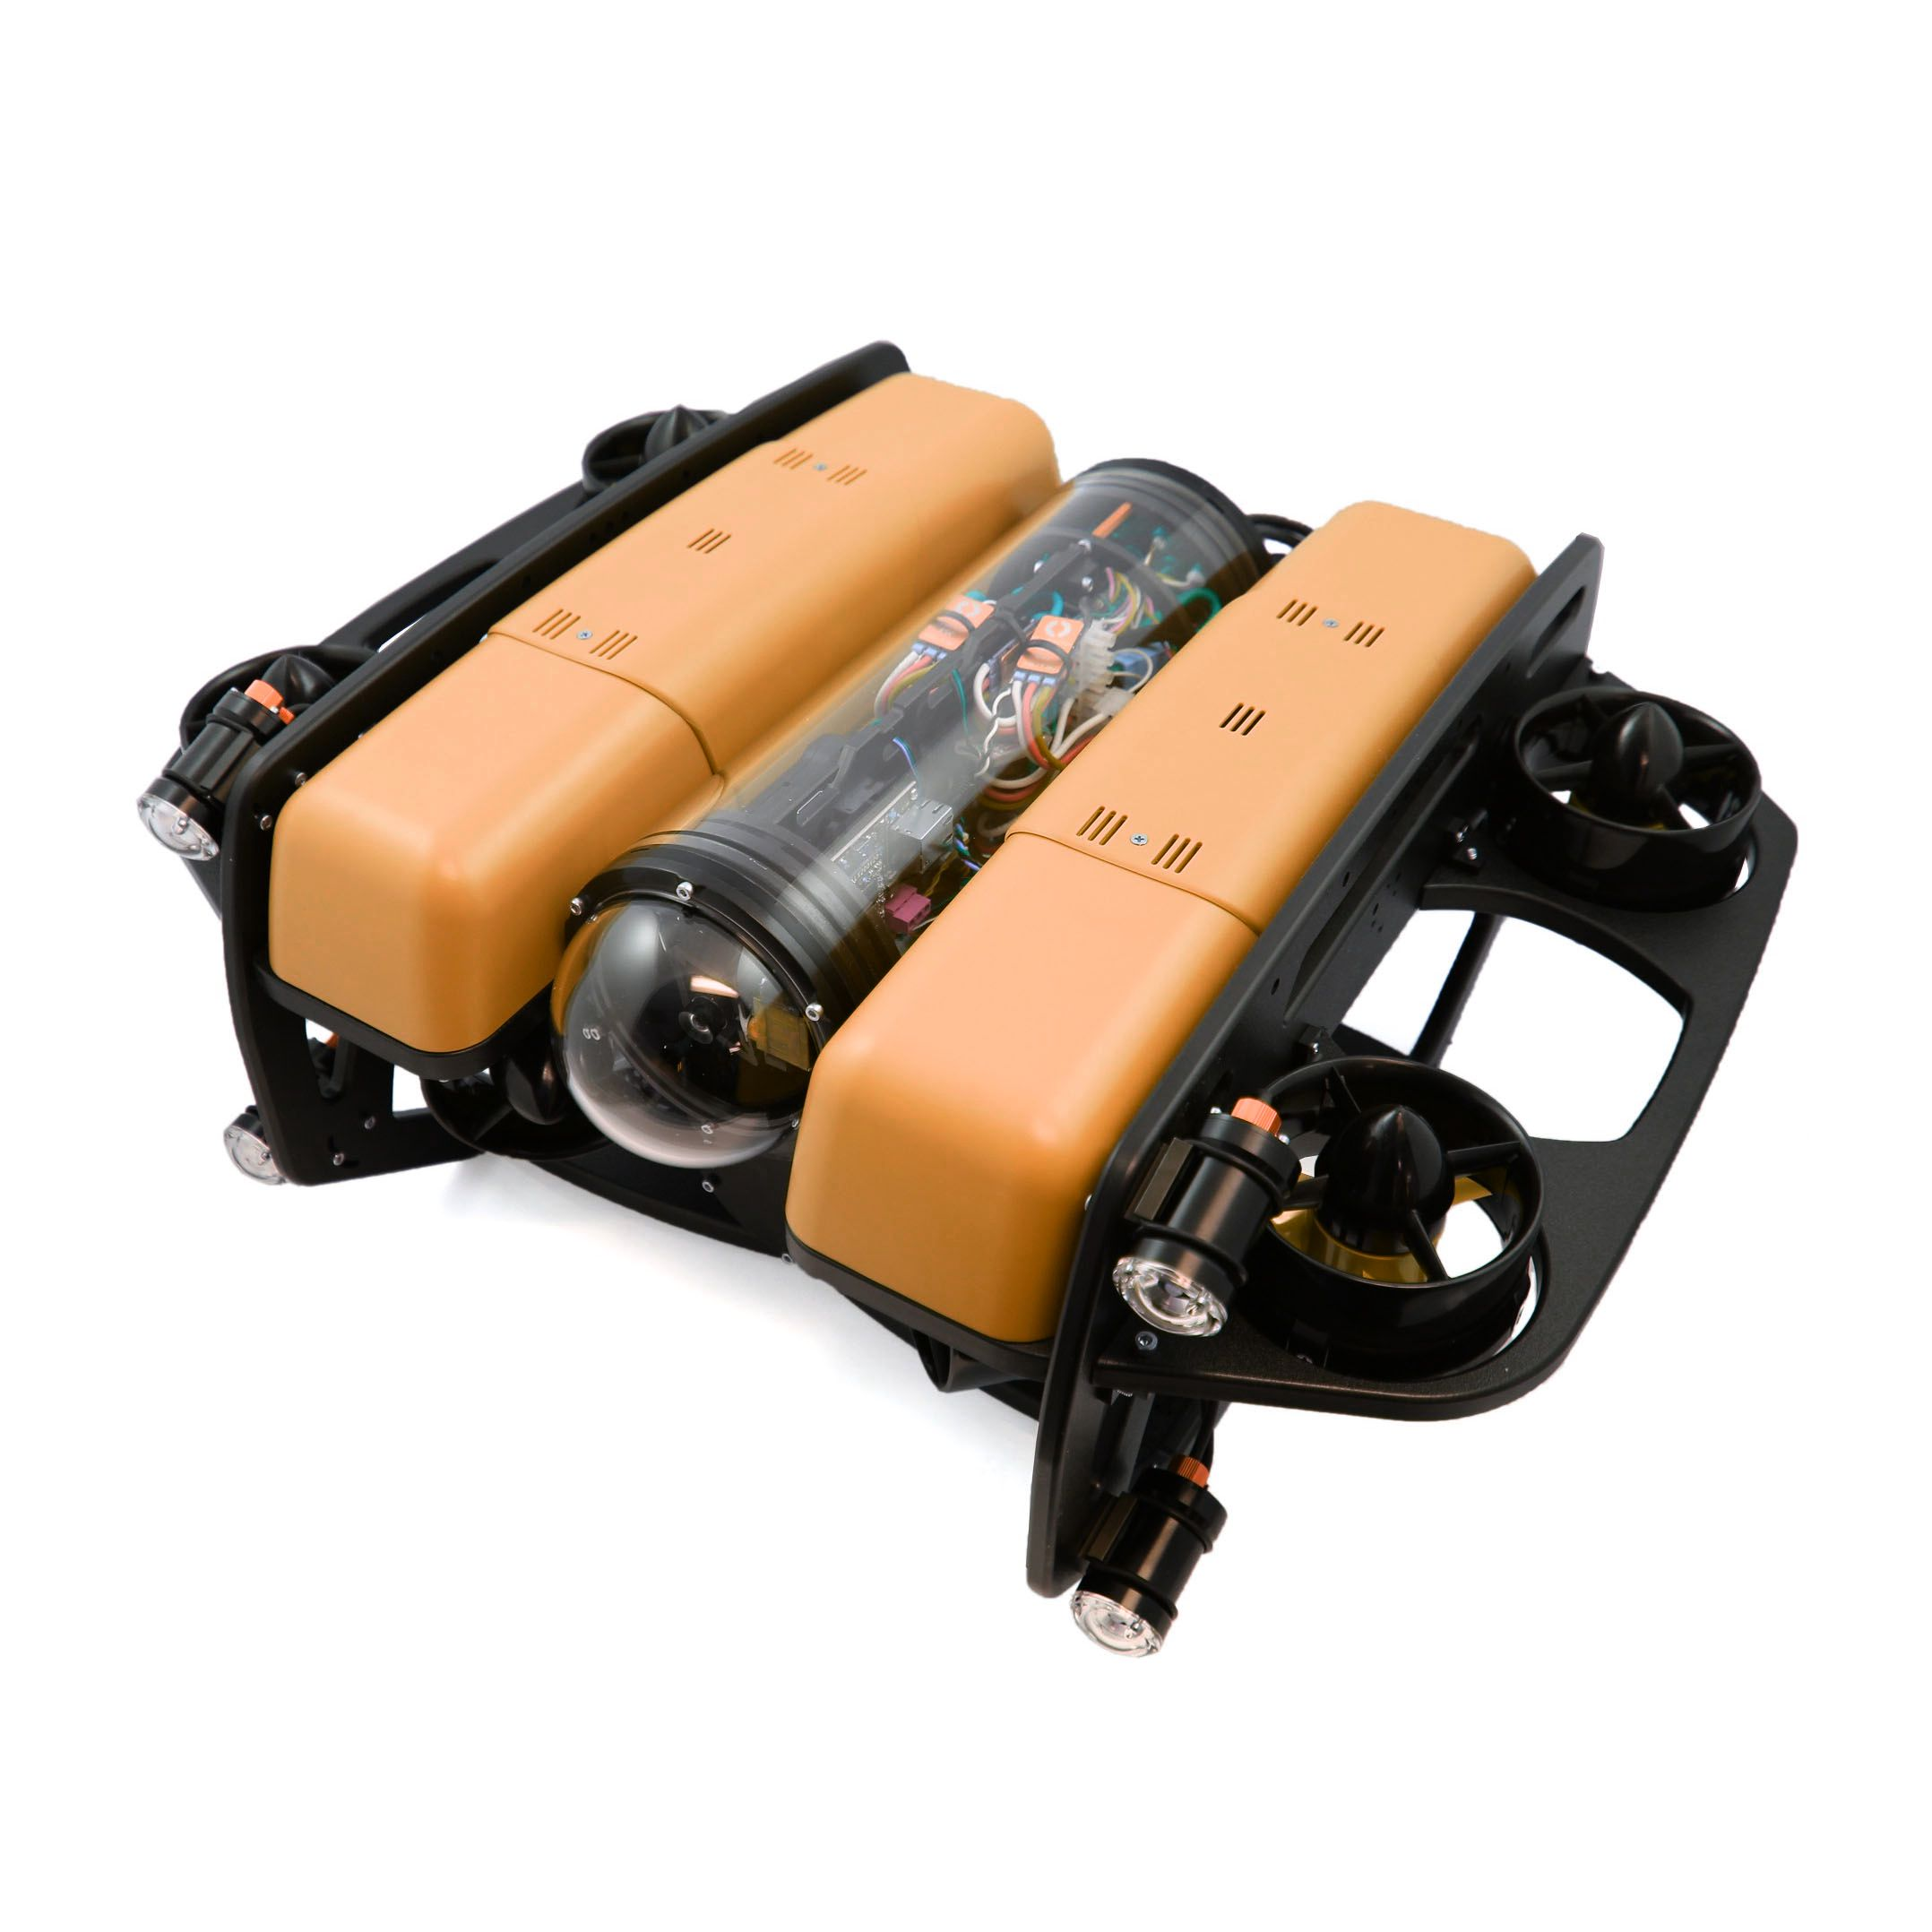
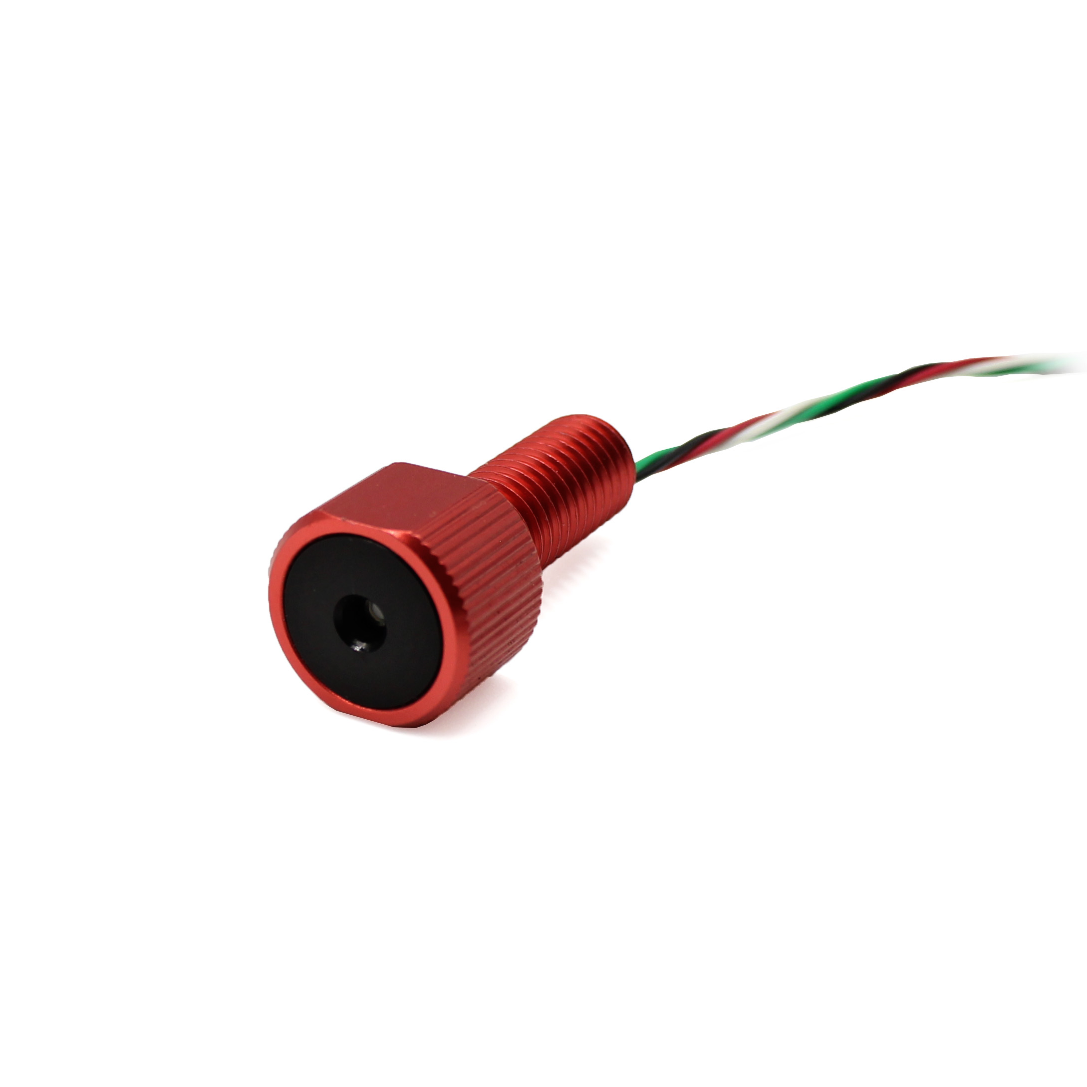
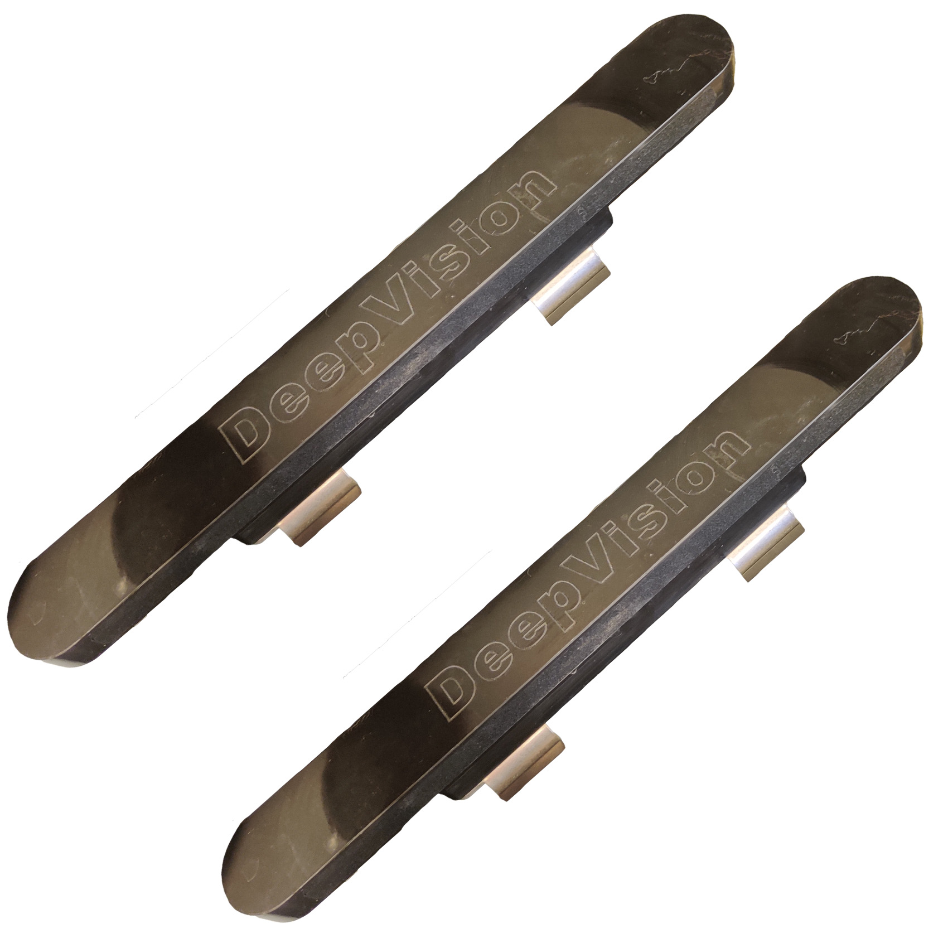
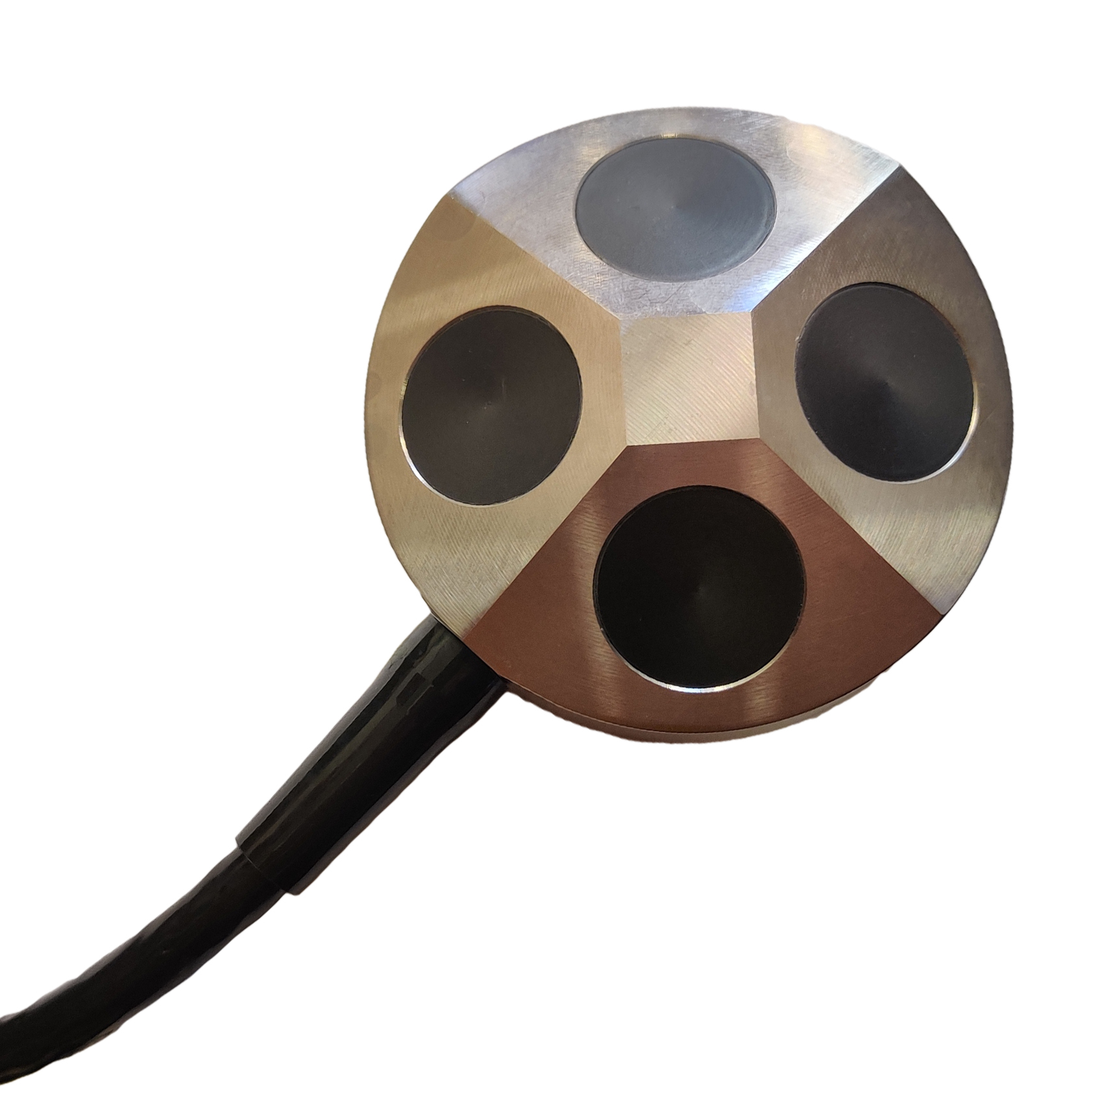
What is ROS?
“The Robot Operating System is a set of software libraries and tools for building robot applications.”
Open-source
Middleware + Libraries
Distributed systems
C++ and Python

Slide 5
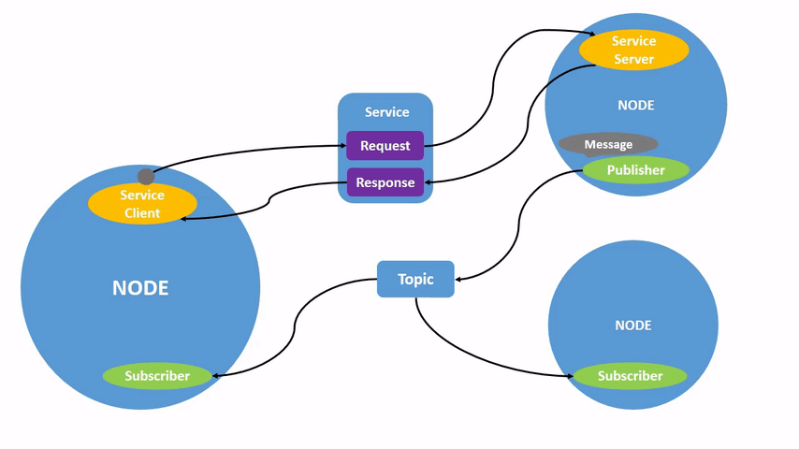
Nodes in ROS 2
Executable program
Single module purpose
Nodes communicate
Topics
Services
Actions
Parameters

Slide 6
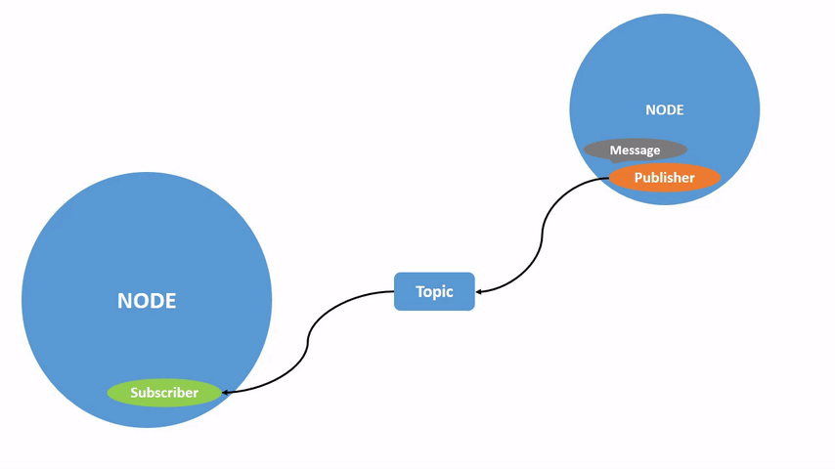
Topics
Bus to exchange messages
Publisher/subscriber mechanism
Message
Type pre-defined
Populate and send
Receive and utilize
Unidirectional

Slide 7
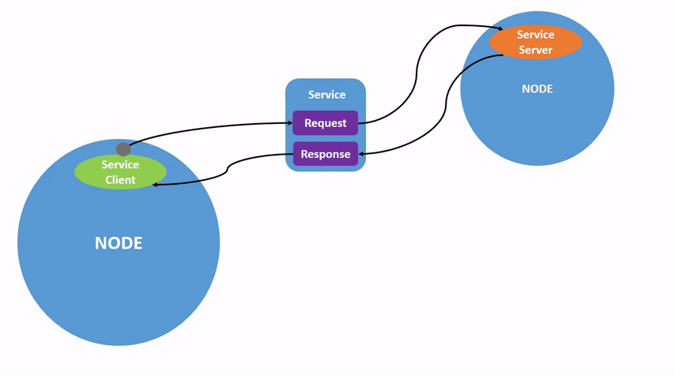
Services
Client and server
Call-and-response mechanism
Not intended for
Continuous calls
Long running tasks
Bidirectional

Slide 8
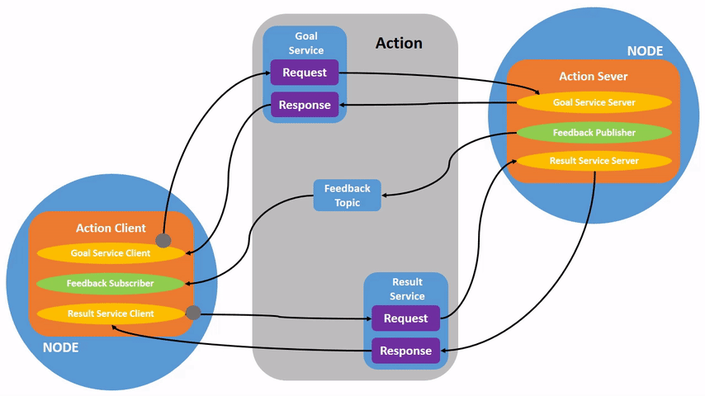
Actions
Topics and services
Action client/server
Long running tasks
Goal
Feedback
Result

Slide 9
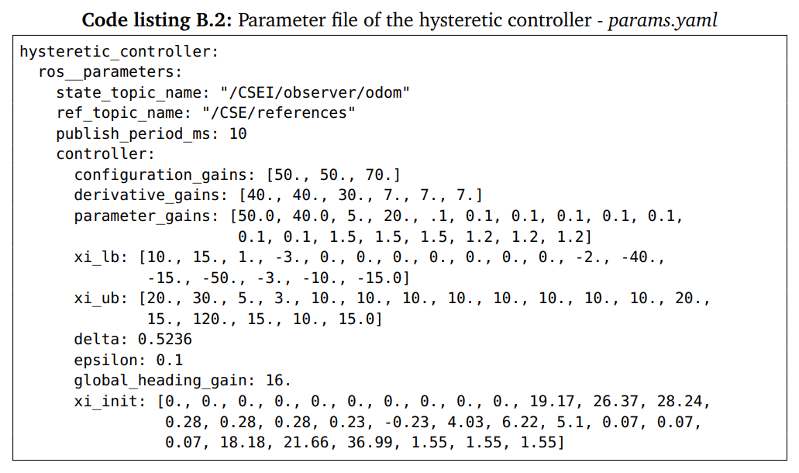
Parameters
Associated with individual nodes
Configuration value
bool, int64, float64, string, byte, arrays
Initialization upon startup
Default values
Load parameter file (.yaml)
Get/set from command line

Slide 10
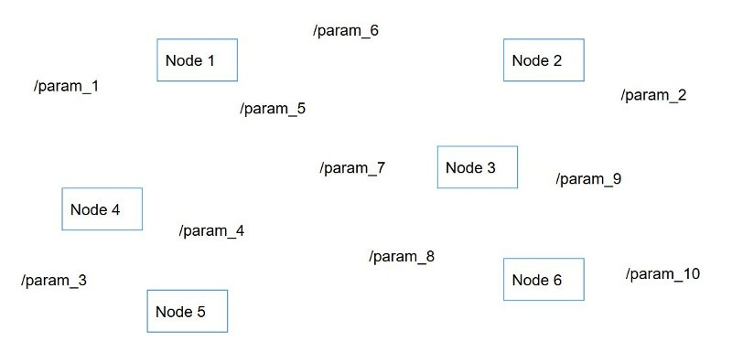
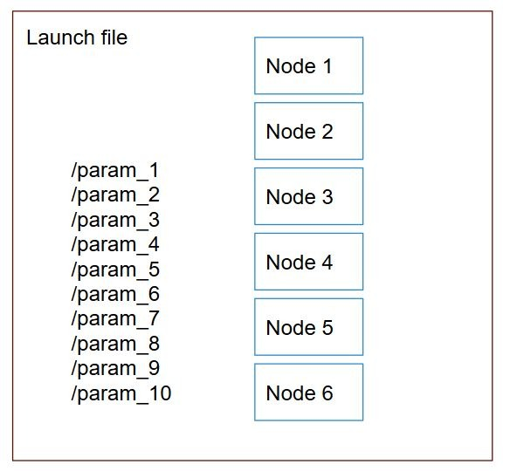
Launch files
Multiple nodes
Scalable
Python, XML, YAML
ros2 launch <package_name> <launch_file_name>

Slide 11
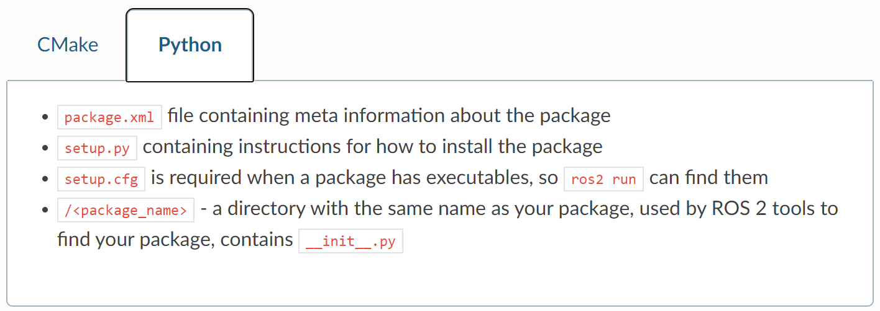
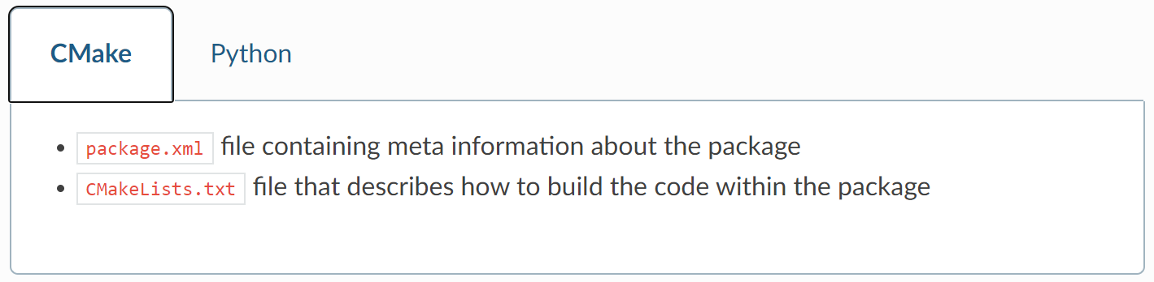
Packages
Container for ROS 2 code
Ament and Colcon
Cmake or Python
Directories
build: intermediate files
install: installment of packages
log: logging information

Slide 12
Good to know!
Ros2 bag
Rqt
Ros1_bridge
Helpful pages
ROS Answers
ROS 2 Documentation
ROS 2 Github repository
Stack Overflow

Slide 13
Coffee time
..or tea, if coffee is not your cup of tea

Slide 14
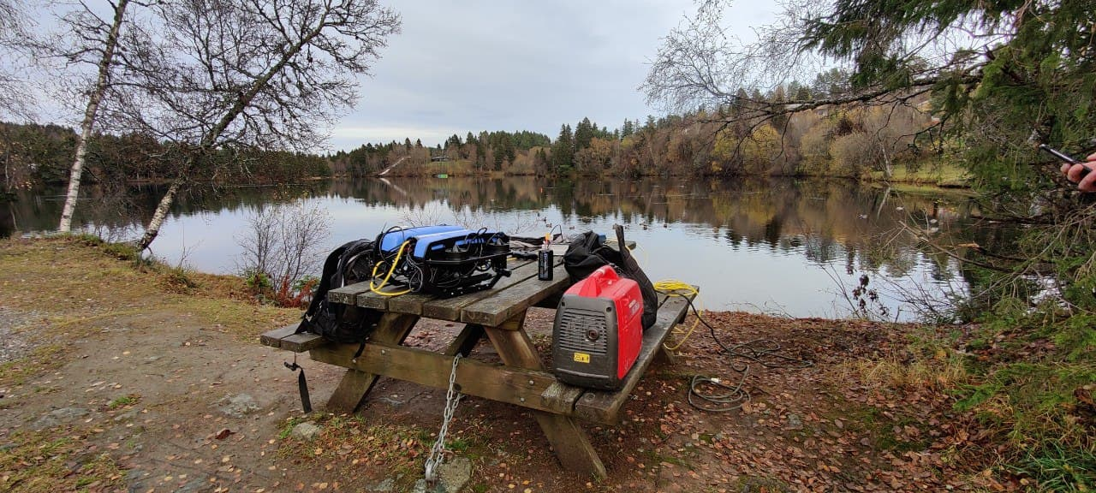
Work related to BlueROV2
Norwegian University of Science and Technology
Outdoor experiment conducted at Kyvannet, Trondheim.

Slide 15
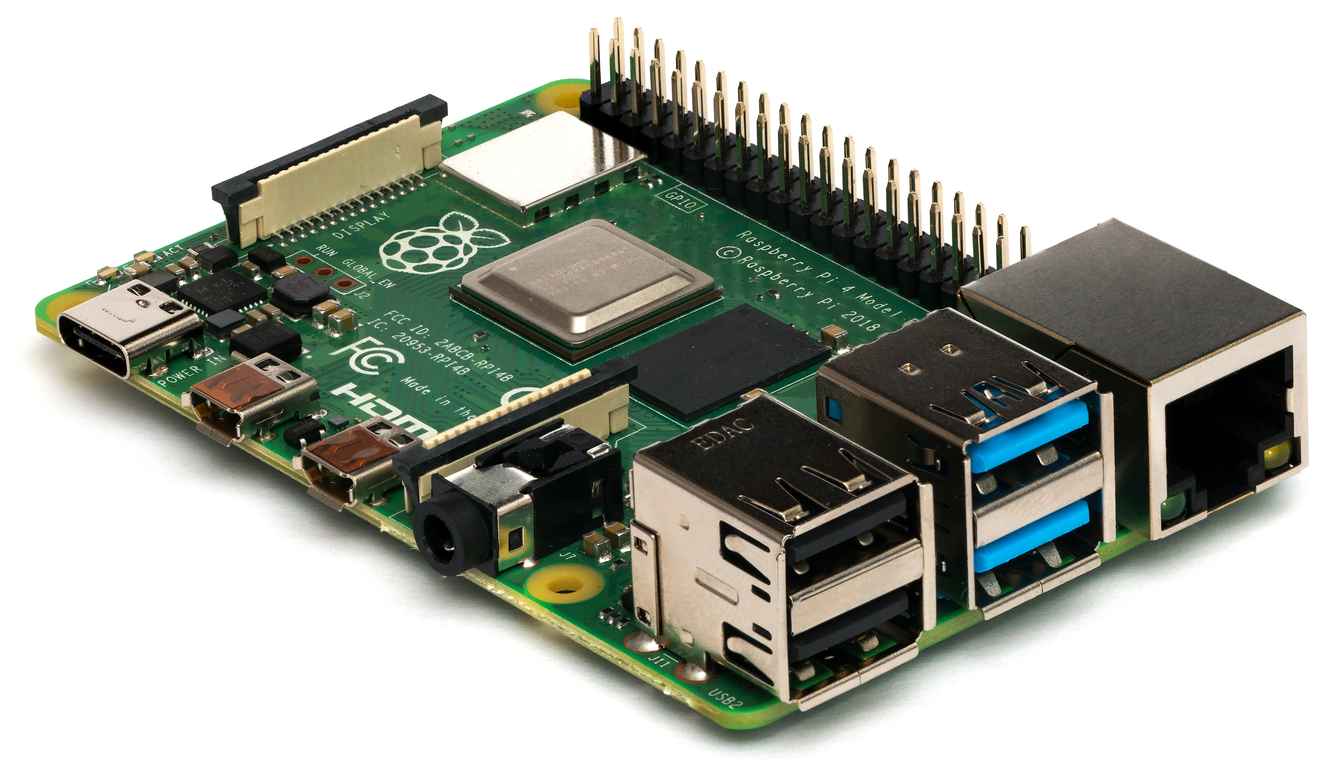
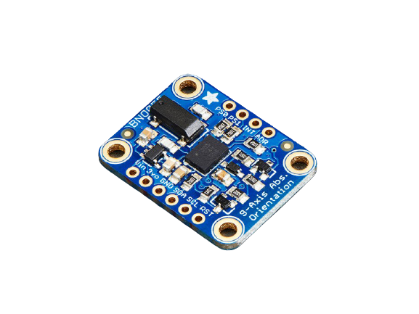
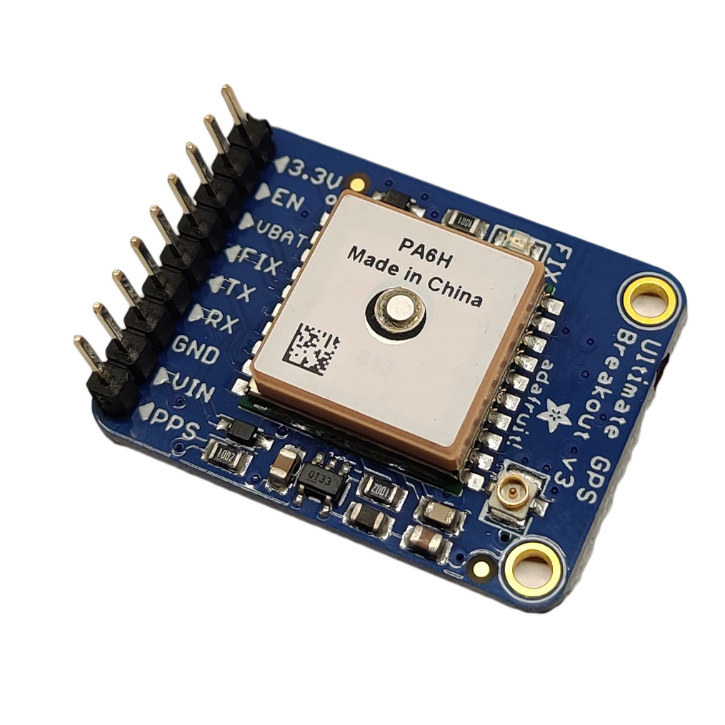
Hardware configuration
BlueROV2 (Blue Robotics Inc)
Raspberry PI 4, model B
Sensor suite
BNO055 IMU (Adafruit/Bosch)
Bar30 pressure sensor (Blue Robotics Inc)
Ultimate GPS (Adafruit)
DVL A50 (Water Linked)
OSM Ethernet Sonar System (DeepVision)
..and more
BlueROV2
RPI4
BNO055
Bar30
Ultimate GPS
DVL A50
Sonar System

Slide 16
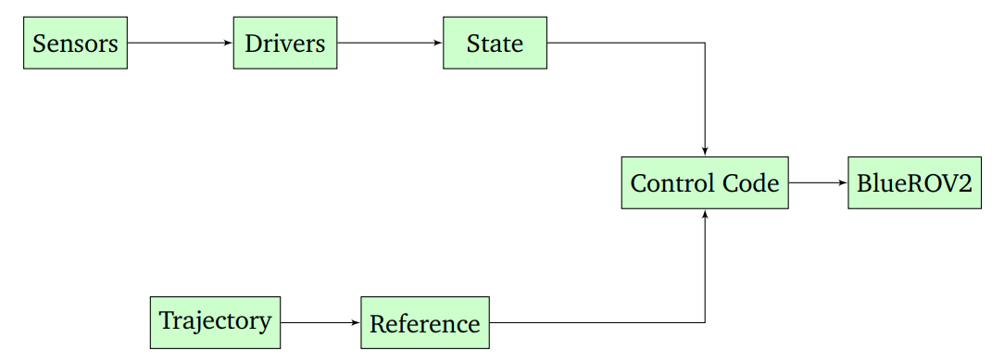
Software configuration
Github: bjornrho/Navigation-brov2
Sensor drivers
IMU, DVL, Sonar, Pressure sensor
GPS
State estimation
Trajectory
Planner
Publisher
Control code
Block diagram of how the software modules and hardware interact.

Slide 17
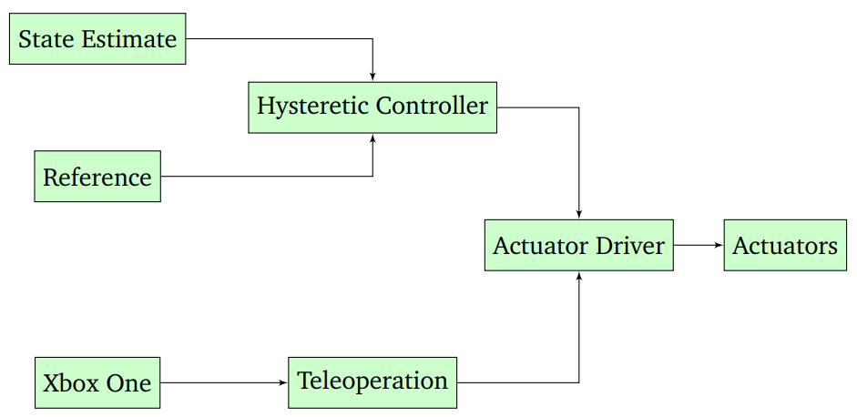
Control code
NTNU AMOS
Hysteretic controller
Actuator driver
Teleoperation driver
Xow
Joy_node

Slide 18
Workshop Summary
ROS concepts
Nodes, communication, parameters, etc.
Code structure
package.xml, CMakeLists.txt
Build → Source → Run
Terminal commands
What now?

Slide 19
Questions?

Slide 20
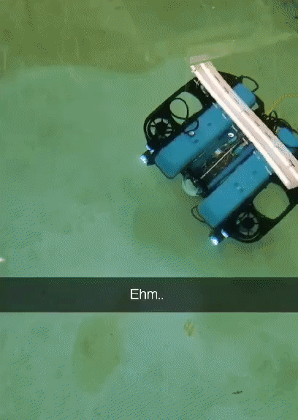
Thanks for tagging along!

